Slide 1



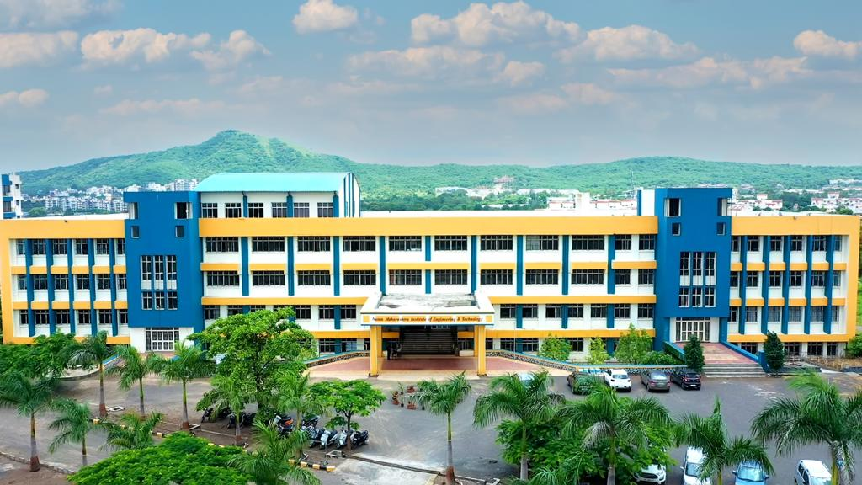
Nutan Maharashtra Vidya Prasarak Mandal's
NUTAN MAHARASHTRA INSTITUTE OF ENGINEERING & TECHNOLOGY, PUNE
Department of Information Technology
NAAC & NBA Accredited
SPPU Project Work Stage – I
Academic Year 2026-27
1

Slide 2
Nutan Maharashtra Vidya Prasarak Mandal's
NUTAN MAHARASHTRA INSTITUTE OF ENGINEERING & TECHNOLOGY, PUNE
Department of Information Technology
A
Project Review
on
“A RAG-Based Multilingual AI Assistant for Government Scheme Discovery and Application Assistance”
Prepared By
Sandesh Ashok Shingankar BEIT60
Amol Subhash Tayade BEIT63
Tejas Balasaheb Naiknaware BEIT71
Guided by
Prof. Roshni Narkhede
PCET’S & NMVPM’S
NUTAN MAHARASHTRA INSTT. OF ENGG. & TECH. Pune
SPPU Project Work Stage – I, A.Y. 2026-27

Slide 3
Nutan Maharashtra Vidya Prasarak Mandal's
NUTAN MAHARASHTRA INSTITUTE OF ENGINEERING & TECHNOLOGY, PUNE
Department of Information Technology
  Content:
  Project Presentation
    Project Title,
    Originality of Problem Statement,
    Depth of Understanding the Problem Statement,
    Concreate Literature Survey with identified gaps in all referred papers,
    Design and Analysis of Algorithm / Model / Architecture / System,
    List of required hardware, software, or other equipment for executing the project,
    project Scope & objective,
    System overview,
    Architecture and initial phase of design (DFD),
    Expected outcome
SPPU Project Work Stage – I, A.Y. 2026-27
3

Slide 4
Nutan Maharashtra Vidya Prasarak Mandal's
NUTAN MAHARASHTRA INSTITUTE OF ENGINEERING & TECHNOLOGY, PUNE
Department of Information Technology
  Project Title
A RAG-Based Multilingual AI Assistant for Government Scheme Discovery and Application Assistance
  Problem Domain
RAG (Retrieval-Augmented Generation, Artificial Intelligence & Machine Learning (AI/ML)
SPPU Project Work Stage – I, A.Y. 2026-27
4

Slide 5
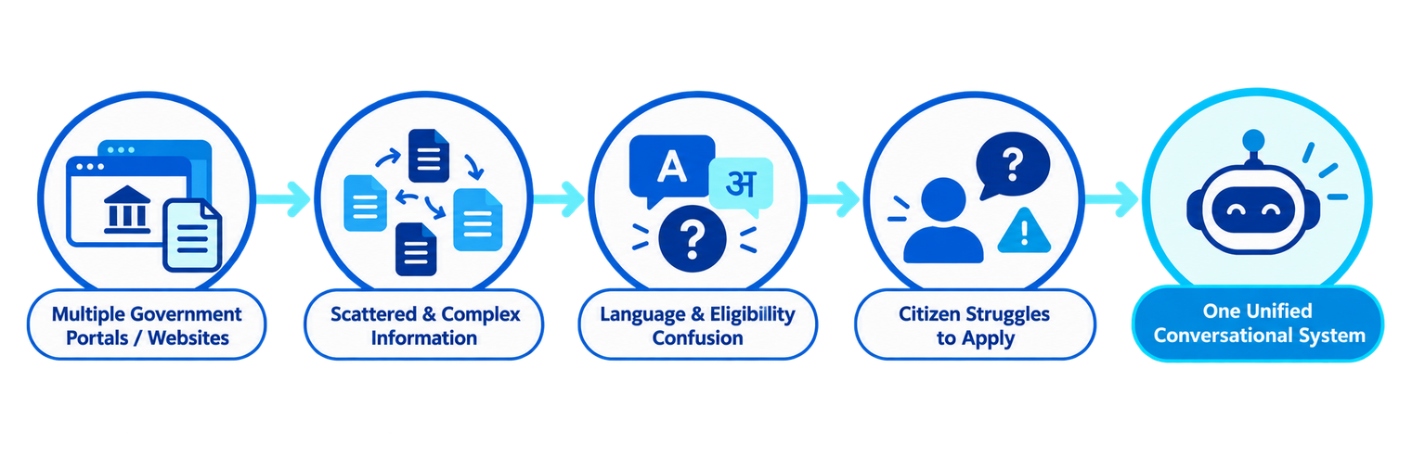
Nutan Maharashtra Vidya Prasarak Mandal's
NUTAN MAHARASHTRA INSTITUTE OF ENGINEERING & TECHNOLOGY, PUNE
Department of Information Technology
  Originality of Problem Statement
Citizens in India, especially in semi-urban and rural areas, struggle to access accurate, up-to-date information about government schemes, certificates, and eligibility criteria. Information is scattered across multiple government portals, often in complex bureaucratic language, primarily in English or formal Marathi/Hindi, making it inaccessible to citizens with limited literacy or digital skills. There is no unified, conversational system that helps citizens discover relevant schemes, check eligibility, and prepare applications with ease.
SPPU Project Work Stage – I, A.Y. 2026-27
5

Slide 6
Nutan Maharashtra Vidya Prasarak Mandal's
NUTAN MAHARASHTRA INSTITUTE OF ENGINEERING & TECHNOLOGY, PUNE
Department of Information Technology
  Depth of Understanding the Problem Statement
Citizens often do not know which government schemes or certificates they are eligible for, and even when they do, the application process is confusing and paperwork-heavy. Existing government websites are static, text-heavy, and not conversational, offering no personalized guidance.
GovKnowledge Hub addresses this by providing a chatbot-based AI assistant, accessible via website and WhatsApp, that ingests government scheme data (eligibility rules, documents required, procedures) into a Retrieval-Augmented Generation (RAG) pipeline. Users can converse in natural language — including Marathi — and ask questions like "Which scholarships can I apply for?" or "Am I eligible for X certificate?" The assistant retrieves relevant scheme information from a vector database, grounds its answers with source citations to minimize hallucination, and additionally helps the user by auto-generating a pre-filled application draft/summary (name, details, required documents checklist) that the user can review and submit on the actual government portal.
SPPU Project Work Stage – I, A.Y. 2026-27
6

Slide 7
Nutan Maharashtra Vidya Prasarak Mandal's
NUTAN MAHARASHTRA INSTITUTE OF ENGINEERING & TECHNOLOGY, PUNE
Department of Information Technology
  Concreate Literature Survey with identified gaps in all referred papers,
Sr. | Year | Paper / Study (Authors) | Key Findings | Methods | Limitations | Link
1 | 2026 | Government Schemes Recommendation (Sheriff et al.) | RAG improves access to government scheme information. | FAISS, LangChain, GenAI, React, Node.js, FastAPI | Limited schemes; English/Tamil only. | Open
2 | 2026 | AI-Driven Chatbot for Govt Scheme Accessibility (Vaishnavi et al.) | Hybrid RAG achieves 90.4% retrieval accuracy. | BM25, Dense Embeddings, Reranking, Local LLM | Requires updated scheme database. | Open
3 | 2026 | Groundedness in Government Document Chatbots (Rumamby et al.) | Identifies weaknesses in existing RAG evaluation metrics. | Systematic Literature Review, PRISMA | Proposed metric needs validation. | Open
4 | 2026 | AgriGov: Structured Multilingual Dataset (Bilal & Gopakumar) | Provides multilingual agricultural scheme data. | Web Scraping, Machine Translation, Human Review | Focuses only on agricultural schemes. | Open
5 | 2025 | Government Schemes Recommendation API (Reddy et al.) | Multilingual RAG simplifies welfare scheme discovery. | FAISS, LangChain, FastAPI, Eligibility Filtering | Limited schemes and languages. | Open
6 | 2024 | Need of RAG for Conversational Assistants (Vaidheeswaran & Nathan) | RAG improves answer quality and reduces hallucinations. | Comparative Experiments, Hybrid Retrieval, ASR/TTS | Limited to the studied welfare-scheme domain. | Open
7 | 2024 | Two-Phase RAG Chatbot for Italian Funding (Boccato et al.) | Two-stage RAG improves information retrieval. | Two-Phase RAG, Summary-Based Retrieval | Domain-specific; moderate user satisfaction. | Open
SPPU Project Work Stage – I, A.Y. 2026-27
7

Slide 8
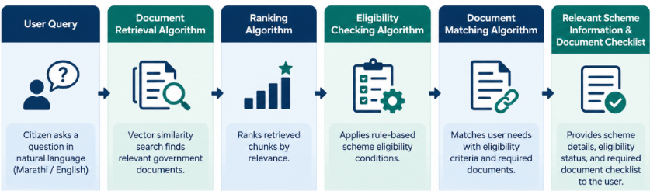
Nutan Maharashtra Vidya Prasarak Mandal's
NUTAN MAHARASHTRA INSTITUTE OF ENGINEERING & TECHNOLOGY, PUNE
Department of Information Technology
  Design and Analysis of Algorithms
  Algorithms Used:
  Document Retrieval Algorithm: Retrieves relevant government documents based on user queries using vector similarity search.
  Ranking Algorithm: Ranks retrieved document chunks according to their relevance to the user's question.
  Eligibility Checking Algorithm: Applies rule-based conditions to check users' eligibility for government schemes.
  Document Matching Algorithm: Matches user requirements with scheme eligibility criteria and required documents.
SPPU Project Work Stage – I, A.Y. 2026-27
8

Slide 9
Nutan Maharashtra Vidya Prasarak Mandal's
NUTAN MAHARASHTRA INSTITUTE OF ENGINEERING & TECHNOLOGY, PUNE
Department of Information Technology
  Algorithm Analysis:
  Time Complexity: Depends on the retrieval method, dataset size, and number of eligibility rules.
  Space Complexity: Depends on the number of stored document chunks, embeddings, and indexing structures.
  Optimization: Efficient indexing and retrieval reduce search time and improve response efficiency.
  Design of Model
  Input: User query in Marathi or English.
  Embedding Model: Converts user queries and government documents into vector representations.
  RAG Model: Retrieves relevant document context and generates answers using an LLM.
  Output: Provides answers with source citations, eligibility guidance, and a required document checklist.
SPPU Project Work Stage – I, A.Y. 2026-27
9

Slide 10
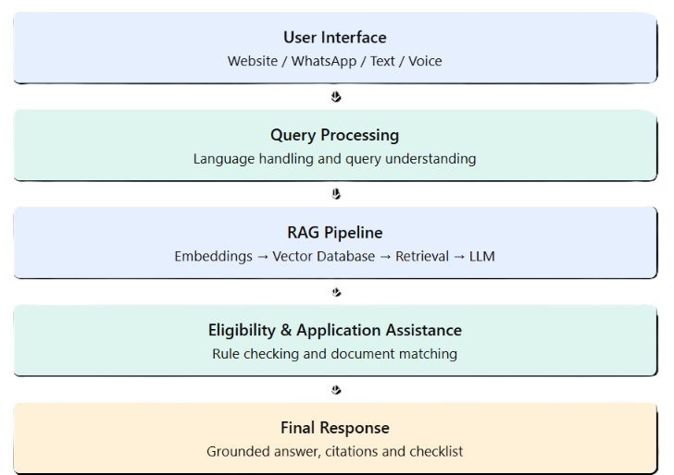
Nutan Maharashtra Vidya Prasarak Mandal's
NUTAN MAHARASHTRA INSTITUTE OF ENGINEERING & TECHNOLOGY, PUNE
Department of Information Technology
  System Architecture:
SPPU Project Work Stage – I, A.Y. 2026-27
10

Slide 11
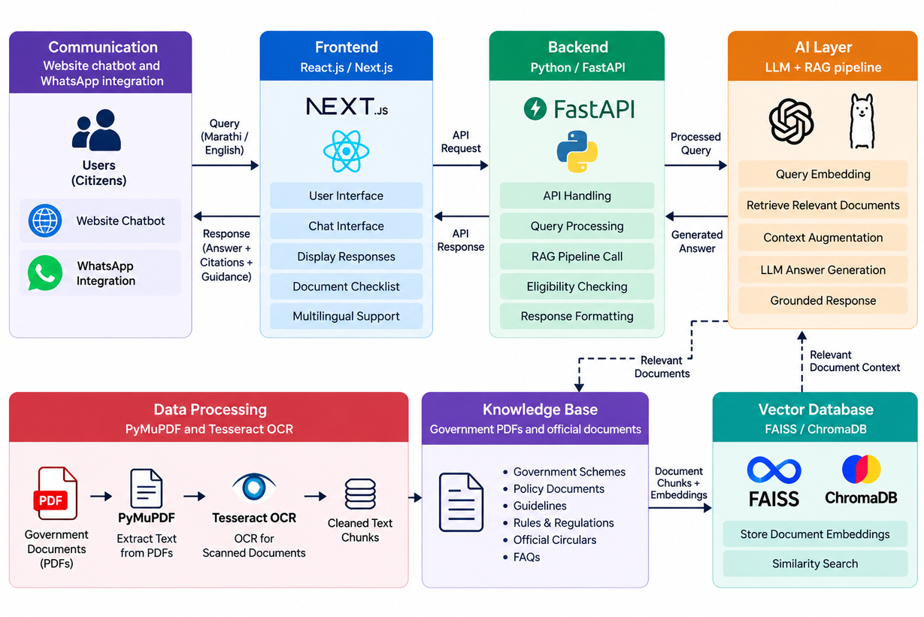
Nutan Maharashtra Vidya Prasarak Mandal's
NUTAN MAHARASHTRA INSTITUTE OF ENGINEERING & TECHNOLOGY, PUNE
Department of Information Technology
  System Design
SPPU Project Work Stage – I, A.Y. 2026-27
11

Slide 12
Nutan Maharashtra Vidya Prasarak Mandal's
NUTAN MAHARASHTRA INSTITUTE OF ENGINEERING & TECHNOLOGY, PUNE
Department of Information Technology
  List of Required Hardware, Software, and Other Equipment
1. Hardware Requirements
3. Other Requirements
  Processor: Intel Core i5 / AMD Ryzen 5 or equivalent
  RAM: Minimum 8 GB (16 GB recommended)
  Storage: Minimum 256 GB SSD
  Internet Connection: Stable broadband connection
  Display: Standard monitor or laptop display
  Official government PDFs, scheme guidelines, GRs, and circulars
  API key and internet access for the selected LLM service
  Government document datasets for testing and validation
  WhatsApp Business API access, if WhatsApp integration is implemented
  Cloud hosting or a deployment platform, if online deployment is required
2. Software Requirements
  Operating System: Windows 10/11 or Linux
  Frontend: React.js / Next.js, HTML, CSS, JavaScript
  Backend: Python and FastAPI
  AI / LLM: OpenAI API or a compatible LLM
  RAG Framework: LangChain
  Vector Database: FAISS or ChromaDB
  Document Processing: PyMuPDF and Tesseract OCR
  Development Tools: Visual Studio Code, Git, GitHub, Postman
  Database: SQLite or PostgreSQL, if required
  Browser: Google Chrome or Microsoft Edge
SPPU Project Work Stage – I, A.Y. 2026-27
12

Slide 13
Nutan Maharashtra Vidya Prasarak Mandal's
NUTAN MAHARASHTRA INSTITUTE OF ENGINEERING & TECHNOLOGY, PUNE
Department of Information Technology
  Project Scope
  Develop an AI-powered platform for accessing government schemes, rules, GRs, and official documents.
  Implement a Retrieval-Augmented Generation (RAG) system to provide answers based on relevant government sources.
  Support multilingual interaction in Marathi and English.
  Provide source citations to help users verify the information.
  Assist citizens in understanding scheme eligibility criteria and required documents.
  Generate document checklists and application guidance.
  Provide a user-friendly web interface with optional WhatsApp and voice integration.
  Evaluate retrieval accuracy, answer relevance, citation correctness, and response reliability.
SPPU Project Work Stage – I, A.Y. 2026-27
14

Slide 14
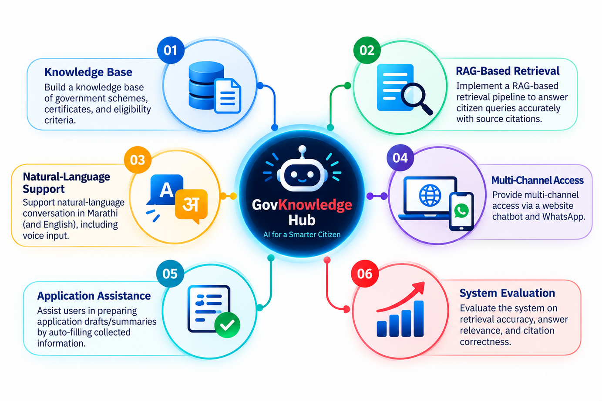
Nutan Maharashtra Vidya Prasarak Mandal's
NUTAN MAHARASHTRA INSTITUTE OF ENGINEERING & TECHNOLOGY, PUNE
Department of Information Technology
  Project Objectives
SPPU Project Work Stage – I, A.Y. 2026-27
15

Slide 15
Nutan Maharashtra Vidya Prasarak Mandal's
NUTAN MAHARASHTRA INSTITUTE OF ENGINEERING & TECHNOLOGY, PUNE
Department of Information Technology
  System Overview
GovKnowledge Hub is an AI-powered platform designed to simplify access to government schemes, rules, GRs, and official documents. It uses Retrieval-Augmented Generation (RAG) to retrieve relevant information from official government sources and generate context-based answers using a Large Language Model (LLM).
The system supports Marathi and English queries, provides source citations for verification, and assists citizens in understanding eligibility criteria, required documents, and application procedures.
  System Workflow
  User Input: Citizens submit queries in Marathi or English through the web interface.
  Query Processing: The system processes the query and prepares it for retrieval.
  Knowledge Retrieval: Relevant information is retrieved from the government document knowledge base using embeddings and vector similarity search.
  Answer Generation: The LLM generates a response based on the retrieved context.
  Eligibility Assistance: The system helps users understand scheme eligibility and document requirements.
  Response Delivery: The system presents the answer with source citations, eligibility guidance, and a document checklist.
SPPU Project Work Stage – I, A.Y. 2026-27
16

Slide 16
Nutan Maharashtra Vidya Prasarak Mandal's
NUTAN MAHARASHTRA INSTITUTE OF ENGINEERING & TECHNOLOGY, PUNE
Department of Information Technology
  System Overview
GovKnowledge Hub is an AI-powered platform designed to simplify access to government schemes, rules, GRs, and official documents. It uses Retrieval-Augmented Generation (RAG) to retrieve relevant information from official government sources and generate context-based answers using a Large Language Model (LLM).
The system supports Marathi and English queries, provides source citations for verification, and assists citizens in understanding eligibility criteria, required documents, and application procedures.
  System Workflow
  User Input: Citizens submit queries in Marathi or English through the web interface.
  Query Processing: The system processes the query and prepares it for retrieval.
  Knowledge Retrieval: Relevant information is retrieved from the government document knowledge base using embeddings and vector similarity search.
  Answer Generation: The LLM generates a response based on the retrieved context.
  Eligibility Assistance: The system helps users understand scheme eligibility and document requirements.
  Response Delivery: The system presents the answer with source citations, eligibility guidance, and a document checklist.
SPPU Project Work Stage – I, A.Y. 2026-27
17

Slide 17
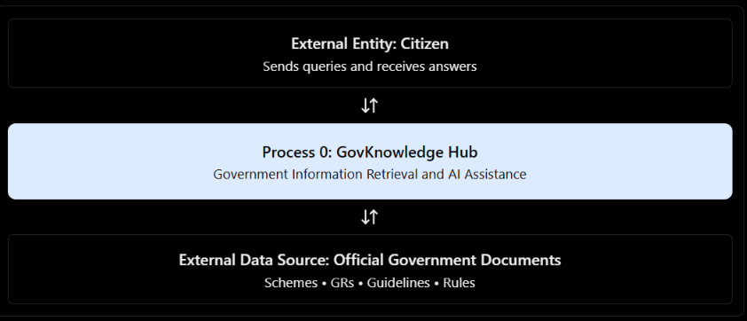
Nutan Maharashtra Vidya Prasarak Mandal's
NUTAN MAHARASHTRA INSTITUTE OF ENGINEERING & TECHNOLOGY, PUNE
Department of Information Technology
  Initial Phase of Design — Data Flow Diagram (DFD)
  DFD Level 0 — Context Diagram
SPPU Project Work Stage – I, A.Y. 2026-27
18

Slide 18
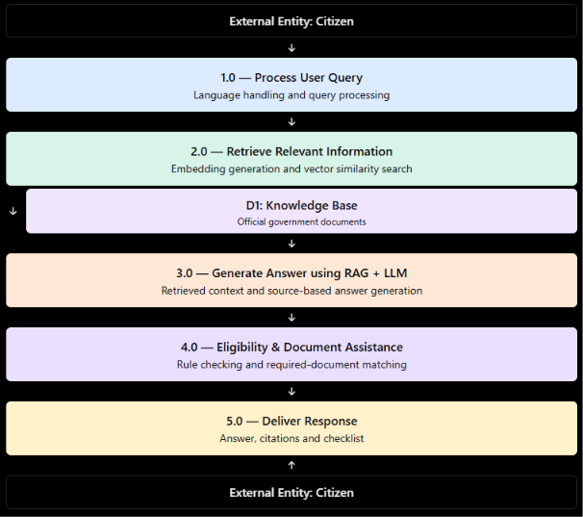
Nutan Maharashtra Vidya Prasarak Mandal's
NUTAN MAHARASHTRA INSTITUTE OF ENGINEERING & TECHNOLOGY, PUNE
Department of Information Technology
  Initial Phase of Design — Data Flow Diagram (DFD)
  DFD Level 1 — Detailed Data Flow
SPPU Project Work Stage – I, A.Y. 2026-27
19

Slide 19
Nutan Maharashtra Vidya Prasarak Mandal's
NUTAN MAHARASHTRA INSTITUTE OF ENGINEERING & TECHNOLOGY, PUNE
Department of Information Technology
    Expected outcome
  Centralized Government Information: A unified platform to access government schemes, GRs, rules, guidelines, and official documents.
  Accurate AI Responses: RAG-based answers generated using relevant government document context.
  Multilingual Accessibility: Support for queries in Marathi and English.
  Source-Based Answers: Citations that help users verify information against official documents.
  Eligibility Assistance: Simplified guidance on government scheme eligibility criteria.
  Document Checklist Generation: Identification of required documents for schemes and government services.
  Improved User Experience: Easy access to government information through a user-friendly web interface.
  Reliable Information Retrieval: Evaluation of retrieval accuracy, answer relevance, citation correctness, and response groundedness.
SPPU Project Work Stage – I, A.Y. 2026-27
20

Slide 20
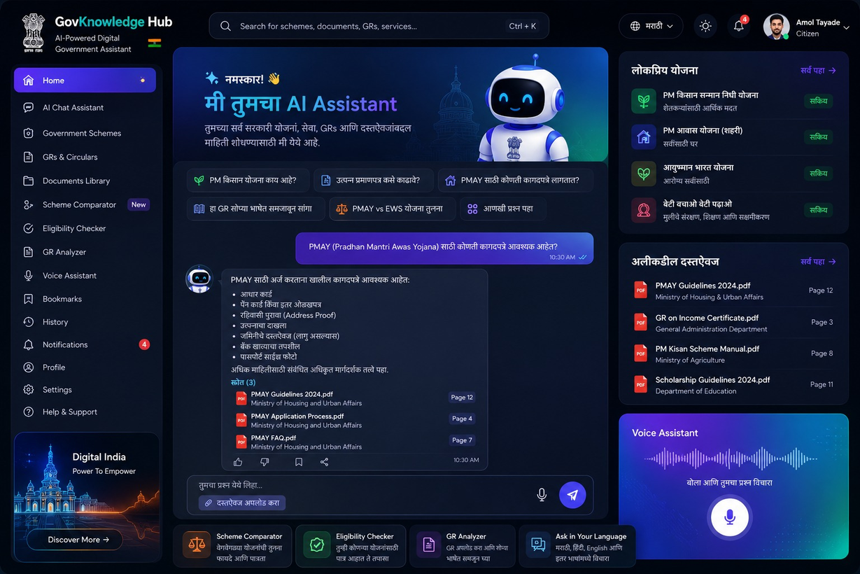
Nutan Maharashtra Vidya Prasarak Mandal's
NUTAN MAHARASHTRA INSTITUTE OF ENGINEERING & TECHNOLOGY, PUNE
Department of Information Technology
    Expected outcome
SPPU Project Work Stage – I, A.Y. 2026-27
21

Slide 21
Nutan Maharashtra Vidya Prasarak Mandal's
NUTAN MAHARASHTRA INSTITUTE OF ENGINEERING & TECHNOLOGY, PUNE
Department of Information Technology
Thank You
FOR YOUR ATTENTION
SPPU Project Work Stage – I, A.Y. 2026-27
22

